Slide 1

NewsNest — A Clean, Fast News Aggregator
Student web-dev capstone: a responsive, client-side news aggregation system built with HTML, CSS, and JavaScript. Purpose-built for clarity, speed, and easy customization — ideal for classmates, instructors, and potential recruiters.

Slide 2

Why NewsNest?
Single place for news
Offline-first approach
Centralizes articles across categories so users spend less time hunting and more time reading.
Local Storage preserves users, articles, and saved items — no backend required for demo or prototype.
Responsive UI
CSS Grid + Flexbox deliver a predictable layout across phones, tablets, and desktops.

Slide 3
Project Architecture (High Level)
Frontend UI
Storage Layer
Admin & User Modules

Slide 4

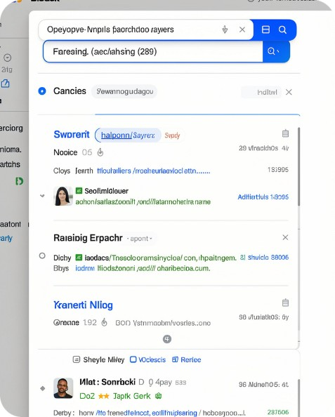

Core Features — User Module
Signup & Login
Search & Filter
Saved Articles
Simple client-side authentication using Local Storage to persist user profiles and session state.
Keyword search and category filters (World, Tech, Sports, Entertainment) make discovery fast and intuitive.
Users can save articles locally for later reading — persisted across sessions via Local Storage.

Slide 5
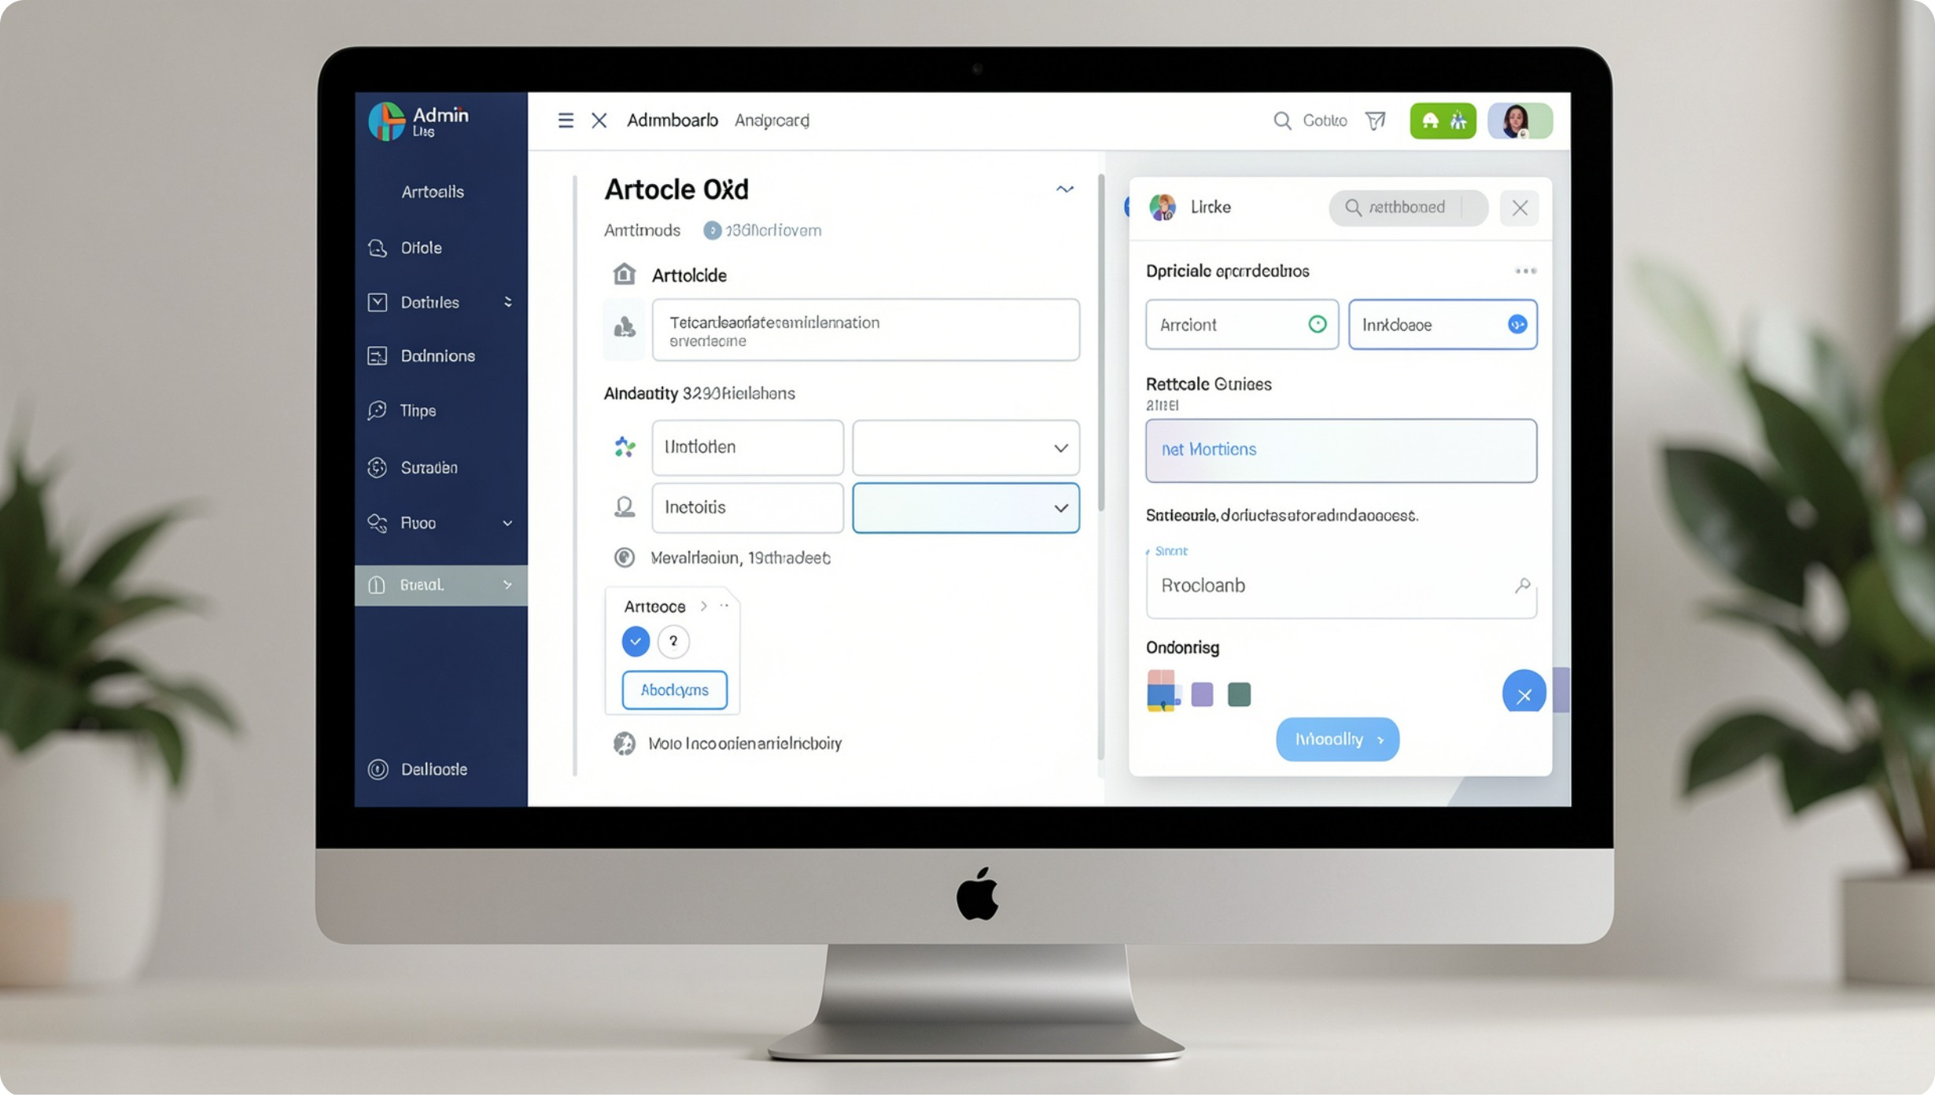
Core Features — Admin Module
Content Management: Admins can add, edit, and delete articles directly from the interface — changes update Local Storage instantly.
System View: Basic metrics and article lists for quick moderation and verification.
Permission gate: Admin functions are restricted in the UI to authorized accounts stored locally.

Slide 6
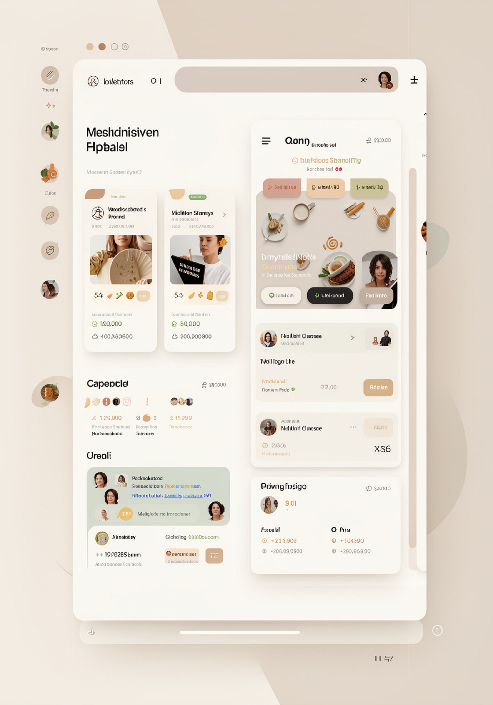


Design & UX Details
Layout
Accessibility
CSS Grid for the article feeds; Flexbox for cards and toolbars — reliable, semantic structure.
Keyboard-focusable controls, clear contrast, and semantic HTML for screen readers.

Slide 7

Implementation Notes
Tech stack: HTML5, modern CSS (Grid + Flexbox), vanilla JavaScript (ES6+)
Data model: Articles, Users, SavedArticles — serialized as JSON in Local Storage
Key patterns: Modular functions, event-driven UI updates, DOM-based templating
Testing: Manual QA across mobile and desktop; edge-case handling for empty or corrupt Local Storage

Slide 8

Demo Walkthrough (Key Flows)
Signup/Login
Browse
Search
Save
We’ll demo these flows in-class to highlight responsiveness, search accuracy, and save/restore behavior with Local Storage.

Slide 9



Strengths, Limitations, & Future Work
1
2
Strength — Simplicity
Limitation — Scalability
Deployable without a server; great for prototypes and portfolio demos.
Local Storage is not suitable for large-scale multi-user apps or cross-device sync.
3
Future — Backend & Auth
Planned upgrades: REST API + persistent DB, OAuth/Secure auth, user sync, and richer analytics.

Slide 10


Wrap — How to Evaluate NewsNest
What to look for: intuitive browsing, reliable save/restore, clean responsive layouts, and clear code structure. Thank you — ready for questions, code review, and live demo.
Theme accents: #e7bf6aff, #DFAB58, #EBCC75, #FDF4DB — used throughout for emphasis and UI accents.

